Slide 1


Dreamcast Audio
Sean Hunt
Sega of America
Confidential
Notes:
Your notes here.

Slide 2
Dreamcast Audio
Sound Hardware overview
  Yamaha AICA
    64 Audio channels (voices)
    QSound™ support (3D Audio)
    Hardware on-the-fly ADPCM decompression
    Embedded Advanced RISC Machines ARM7 processor (32 bit, 17 MIPS sus. @25Mhz)
Confidential
Notes:
AICA stands for?

Slide 3
Sound Hardware
    Embedded DSP
      128 step DSP
      24 bit sampling rate
      10 MIPS
      16 Digital Inputs. 16 Digital outs
      64 LPFs with envelopes (one per channel)
      2 LFOs per channel (pitch and amplitude)
      Algorithms can be connected serially or in parallel
Confidential
Notes:
LPF - Low-Pass filters
What is a 128-step DSP

Slide 4
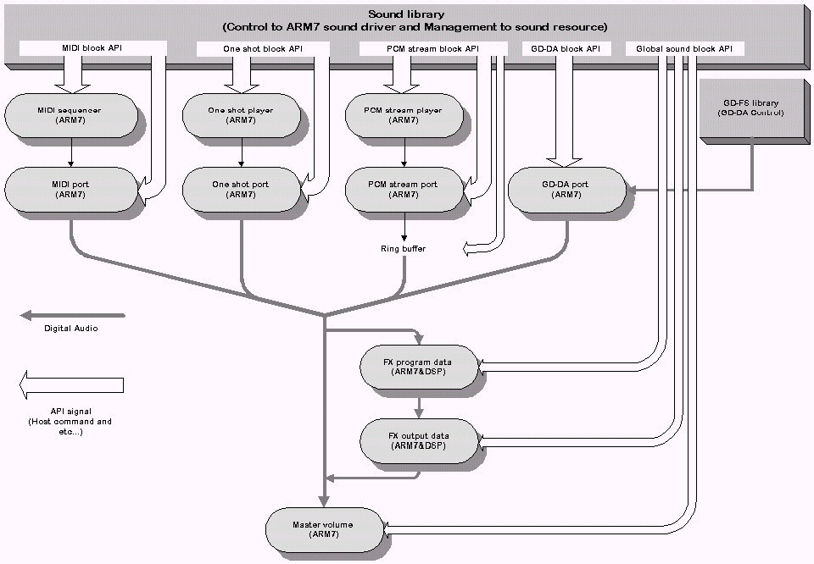
Dreamcast Audio
Data flow
    Refer to Diagram 1-1
Confidential
Notes:
Your notes here.

Slide 5
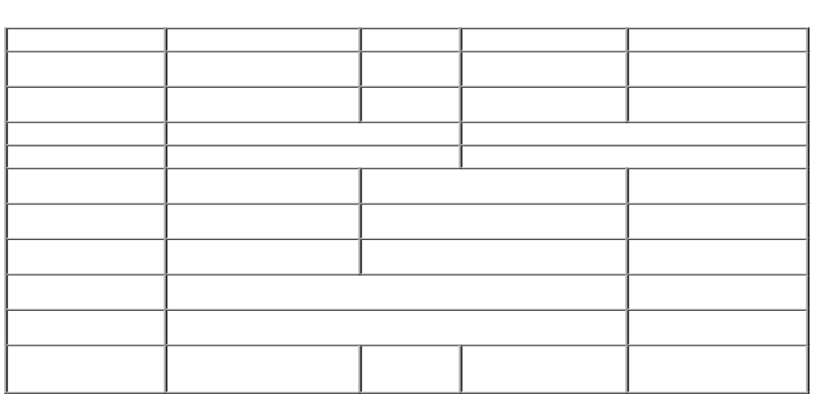
Dreamcast Audio
Confidential
Notes:
Your notes here.

Slide 6
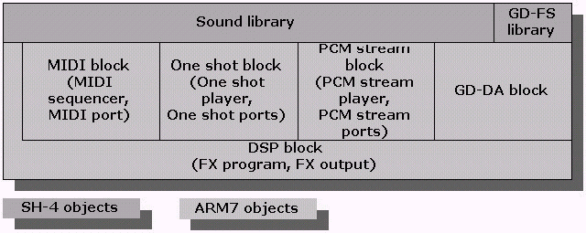
Dreamcast Audio
Confidential
Notes:
General usage; MIDI; either MIDI music or extra sound effects
One-Shot; common sound effects, etc.
PCM stream; voice-over, longer sound effects, infrequently used sounds
GD-DA - duh
FX - general effects, room ambience, 3d spatialization
If I need another one-shot, do I have to stop all sounds and reload all banks/sounds? (MIDI, etc.)

Slide 7
Macintosh tools
Macintosh Tools
Sound Data Converter
MIDI Program Editor
FX Program Editor
Sound Program Manager
Confidential
Notes:
Note; sound memory writes must be word-aligned
symalloc() returns longword aligned, so this is not an issue.

Slide 8
Macintosh Tools
Sound Data Converter
  Handles all conversion from source format to target format (audio files or MIDI sequences)
  3 tools bundled into one
Confidential
Notes:
Note; sound memory writes must be word-aligned
symalloc() returns longword aligned, so this is not an issue.

Slide 9
Macintosh Tools
Sound Data Converter
  PCM stream converter
  One-Shot Bank converter
  MIDI Sequence Bank converter
Confidential
Notes:
Note; sound memory writes must be word-aligned
symalloc() returns longword aligned, so this is not an issue.

Slide 10
Sound Data Converter
  PCM stream converter
    Accepts AIFF, SD2, or WAV format audio files
    Separate into separate left and right streams
    Source data can be 4-bit, 8-bit, or 16-bit; 11.025, 22.5, or 44.1KHz
      any extra information (such as loop points) will be stripped out
Confidential
Notes:
Note; sound memory writes must be word-aligned
symalloc() returns longword aligned, so this is not an issue.

Slide 11
Sound Data Converter
  PCM stream converter (continued)
    Output data can be raw or ADPCM compressed
      compression ratio 2:1 for 8-bit source data, 4:1 for 16-bit
      apply LPF at 1/2 sampling rate to reduce noise
Confidential
Notes:
Note; sound memory writes must be word-aligned
symalloc() returns longword aligned, so this is not an issue.

Slide 12
Sound Data Converter
  PCM stream converter (continued)
    Demo
Confidential
Notes:
Note; sound memory writes must be word-aligned
symalloc() returns longword aligned, so this is not an issue.

Slide 13
Sound Data Converter
  One-Shot data converter
    Accepts AIFF, SD2, or WAV format audio files
    Mono only, < 65534 samples
      reduce sampling rate to get longer sounds
    Source data can be 4-bit, 8-bit, or 16-bit; 11.025, 22.5, or 44.1KHz
      loop points are preserved if present, and do not need to be specially aligned
Confidential
Notes:
Note; sound memory writes must be word-aligned
symalloc() returns longword aligned, so this is not an issue.

Slide 14
Sound Data Converter
  One-Shot data converter (continued)
    Output data is one-shot bank file (.osb) that is used in Sound Project Manager
      compression ratio 2:1 for 8-bit source data, 4:1 for 16-bit (this is for memory savings only - does not allow larger samples)
      apply LPF at 1/2 sampling rate to reduce noise due to compression
Confidential
Notes:
Note; sound memory writes must be word-aligned
symalloc() returns longword aligned, so this is not an issue.

Slide 15
Sound Data Converter
  One-Shot data converter (continued)
    Demo
Confidential
Notes:
Note; sound memory writes must be word-aligned
symalloc() returns longword aligned, so this is not an issue.

Slide 16
Sound Data Converter
  MIDI Sequence Converter
    Accepts SMF type 0 or 1 MIDI files (standard MIDI sequences)
      MIDI Sequence must start with a program change specifying which sound to play; otherwise you will get a sine wave
Confidential
Notes:
Note; sound memory writes must be word-aligned
symalloc() returns longword aligned, so this is not an issue.

Slide 17
Sound Data Converter
  MIDI Sequence Converter (continued)
    Size/number of sequences is limited only by sound memory
      48 note polyphony maximum, anything over that will not sound, and there is a possibility that this will result in audio errors (stuck notes, etc.)
    Output file is .msb used in Sound Project Manager
Confidential
Notes:
Note; sound memory writes must be word-aligned
symalloc() returns longword aligned, so this is not an issue.

Slide 18
Sound Data Converter
  MIDI Sequence Converter (continued)
    Demo
Confidential
Notes:
Note; sound memory writes must be word-aligned
symalloc() returns longword aligned, so this is not an issue.

Slide 19
MIDI Program Editor
MIDI Program Editor
  Creates MIDI tonebanks
  up to 128 banks
  each bank can have up to 128 programs (instruments)
  each instrument can have up to 4 layers
  each layer can have up to 128 splits
  Can be saved in work file format (which can be reopened in this tool) or Sound Project Manager format (cannot be edited)
Confidential
Notes:
Note; sound memory writes must be word-aligned
symalloc() returns longword aligned, so this is not an issue.

Slide 20
MIDI Program Editor
MIDI Program Editor (continued)
    Demo
Confidential
Notes:
Note; sound memory writes must be word-aligned
symalloc() returns longword aligned, so this is not an issue.

Slide 21
FX Program Editor
FX Program Editor
  Creates all effects programs
  Specify input & output channel assignments
  Graphically specify effects algorithms
  Determines RAM needed by DSP for working area (use this information in Sound Project Manager to include this allocation)
  up to 128 steps
  Outputs FX program data (.FPD) file used in Sound Project Manager
Confidential
Notes:
Note; sound memory writes must be word-aligned
symalloc() returns longword aligned, so this is not an issue.

Slide 22
FX Program Editor
FX Program Editor
    Demo
Confidential
Notes:
Note; sound memory writes must be word-aligned
symalloc() returns longword aligned, so this is not an issue.

Slide 23
Sound Project Manager
Sound Project Manager
  Handles allocation of sound memory
    Assets
      One-shot banks (.osb)
      MIDI sequence banks (.msb)
      MIDI Program tonebanks
      FX program data files (fpd)
Confidential
Notes:
Note; sound memory writes must be word-aligned
symalloc() returns longword aligned, so this is not an issue.

Slide 24
Sound Project Manager
Sound Project Manager
    Allocates memory for additional resources resources
      driver
      buffers for PCM streams
      work areas for DSP effects
Confidential
Notes:
Note; sound memory writes must be word-aligned
symalloc() returns longword aligned, so this is not an issue.

Slide 25
Sound Project Manager
Sound Project Manager
    Outputs MultiUnit files (.mlt)
      contains allocation information for each type of resource
      contains sound and program data (all assets except PCM stream and GD-DA)
      Needed for every asset that requires sound memory (eg., all except GD-DA)
Confidential
Notes:
Note; sound memory writes must be word-aligned
symalloc() returns longword aligned, so this is not an issue.

Slide 26
Sound Project Manager
Sound Project Manager
    Demo
Confidential
Notes:
Note; sound memory writes must be word-aligned
symalloc() returns longword aligned, so this is not an issue.

Slide 27
Shinobi Audio API
Overview of API
  terminology
  64 channels (voices), each corresponding to an input channel on the AICA (direct correspondence to a hardware component)
  Ports: handle to a sound buffer, used to group channels together conceptually for global parameter settings; does not correspond to a hardware component.
  Player/module - a specific subset of the driver’s functionality for playing a type of asset; GD-DA, One-Shot, PCM Stream, and MIDI
Confidential
Notes:
Your notes here.

Slide 28
Shinobi Audio API
Overview of API
    Actually part of the Shinobi library, but samples are located under Ninja on the release
    Handles initialization of Audio system
    Handles main memory to sound memory transfers and buffer allocation in sound memory
    Allows control of playback, including parameter changes
Confidential
Notes:
Your notes here.

Slide 29
Shinobi Audio API Classes
Shinobi API Classes
    Sound System API
    Global Sound Control API
    Sound Data Utility API
    Sound Memory Control API
    Memory Block Transfer API
    Sound Module Control API
Confidential
Notes:
Sound System API - functions to set up and monitor status of the sound system
Global - Global volume, stereo/mono toggle, stop all, flush FX, etc.
Sound Data Utility - 2 functions - download Multi-Unit and transfer bank (used to switch banks on the fly without reinit the whole system
Sound Memory Control - used only to get status of bank, returns either error-no init or error illegal type
Memory Block Transfer - Create handle, destroy handle, set parameters, get status
Sound Module Control - all player-specific funtions - play, set parameters, etc. - meat of the API

Slide 30
Shinobi Audio API Classes
  Sound System API
    sdSysXXX(), sdDrvXXX(), sdLibXXX()
    Global initialization
      Library & driver initialization
      flush command
    System driver info
      Error conditions
      Version info, timing info
Confidential
Notes:
Sound System API - functions to set up and monitor status of the sound system
Global - Global volume, stereo/mono toggle, stop all, flush FX, etc.
Sound Data Utility - 2 functions - download Multi-Unit and transfer bank (used to switch banks on the fly without reinit the whole system
Sound Memory Control - used only to get status of bank, returns either error-no init or error illegal type
Memory Block Transfer - Create handle, destroy handle, set parameters, get status
Sound Module Control - all player-specific funtions - play, set parameters, etc. - meat of the API

Slide 31
Shinobi Audio API Classes
  Global Sound Control API
    sdSndXXX()
    Total volume, stereo/mono toggle
    DSP control
      stop command
      set active channels and programs
      Qsound positioning
Confidential
Notes:
Sound System API - functions to set up and monitor status of the sound system
Global - Global volume, stereo/mono toggle, stop all, flush FX, etc.
Sound Data Utility - 2 functions - download Multi-Unit and transfer bank (used to switch banks on the fly without reinit the whole system
Sound Memory Control - used only to get status of bank, returns either error-no init or error illegal type
Memory Block Transfer - Create handle, destroy handle, set parameters, get status
Sound Module Control - all player-specific funtions - play, set parameters, etc. - meat of the API

Slide 32
Shinobi Audio API Classes
  Sound Data Utility API
    Transfer MultiUnit or bank from main memory to sound memory
      sdMultiUnitDownload()
      sdBankDownload()
Confidential
Notes:
Sound System API - functions to set up and monitor status of the sound system
Global - Global volume, stereo/mono toggle, stop all, flush FX, etc.
Sound Data Utility - 2 functions - download Multi-Unit and transfer bank (used to switch banks on the fly without reinit the whole system
Sound Memory Control - used only to get status of bank, returns either error-no init or error illegal type
Memory Block Transfer - Create handle, destroy handle, set parameters, get status
Sound Module Control - all player-specific funtions - play, set parameters, etc. - meat of the API

Slide 33
Shinobi Audio API Classes
  Sound Memory Control API
    gets address and size of selected bank
    sdSndMemGetBankStat()
Confidential
Notes:
Sound System API - functions to set up and monitor status of the sound system
Global - Global volume, stereo/mono toggle, stop all, flush FX, etc.
Sound Data Utility - 2 functions - download Multi-Unit and transfer bank (used to switch banks on the fly without reinit the whole system
Sound Memory Control - used only to get status of bank, returns either error-no init or error illegal type
Memory Block Transfer - Create handle, destroy handle, set parameters, get status
Sound Module Control - all player-specific funtions - play, set parameters, etc. - meat of the API

Slide 34
Shinobi Audio API Classes
  Sound Memory Control API
    sdMemBlockXXX()
    sound memory is accessed via handles
      create/destroy handles (can be reused after transfer occurs)
      use sdMemBlockSetParams() with address & size of the data to set up transfer
Confidential
Notes:
Sound System API - functions to set up and monitor status of the sound system
Global - Global volume, stereo/mono toggle, stop all, flush FX, etc.
Sound Data Utility - 2 functions - download Multi-Unit and transfer bank (used to switch banks on the fly without reinit the whole system
Sound Memory Control - used only to get status of bank, returns either error-no init or error illegal type
Memory Block Transfer - Create handle, destroy handle, set parameters, get status
Sound Module Control - all player-specific funtions - play, set parameters, etc. - meat of the API

Slide 35
Shinobi Audio API Classes
  Sound Module Control API
    class includes all functions for actual playback
    divided into modules
      MIDI
      One-Shot
      PCM stream
    GD-DA functions are actually part of gdFs API
Confidential
Notes:
Sound System API - functions to set up and monitor status of the sound system
Global - Global volume, stereo/mono toggle, stop all, flush FX, etc.
Sound Data Utility - 2 functions - download Multi-Unit and transfer bank (used to switch banks on the fly without reinit the whole system
Sound Memory Control - used only to get status of bank, returns either error-no init or error illegal type
Memory Block Transfer - Create handle, destroy handle, set parameters, get status
Sound Module Control - all player-specific funtions - play, set parameters, etc. - meat of the API

Slide 36
Shinobi API
Shinobi API - Procedural Overview
  Initialization
  Playback
  Buffer management (PCM stream)
Confidential
Notes:
Sound System API - functions to set up and monitor status of the sound system
Global - Global volume, stereo/mono toggle, stop all, flush FX, etc.
Sound Data Utility - 2 functions - download Multi-Unit and transfer bank (used to switch banks on the fly without reinit the whole system
Sound Memory Control - used only to get status of bank, returns either error-no init or error illegal type
Memory Block Transfer - Create handle, destroy handle, set parameters, get status
Sound Module Control - all player-specific funtions - play, set parameters, etc. - meat of the API

Slide 37
Procedural Overview
  Initialization Process - Driver
  Initialize the Sound Library. (sdLibInit())
  Get a Memory Block Handle. (sdMemBlkCreate())
  Set the Memory Block Handle parameters with address and size of driver (sdMemBlkSetPrm())
  Download and initialize the Sound Driver (sdDrvInit())
    Actual transfer from main memory to sound memory (non-DMA)
    Can release SH4 memory now
    ARM7 driver program initializes
Confidential
Notes:
SDE_ERR sdLibInit( Void *wrk_ptr,
Sint32 mem_blk_handle_max,
Sint32 second_host_cmd_max); use NULL, 0, 0 (this may be expanded in the future)
SDE_ERR sdMemBlkCreate( SDMEMBLK *handle)
Prototype SDE_ERR sdMemBlkSetPrm( SDMEMBLK handle, Void *ptr,Uint32 data_size, SD_MEMBLK_CALLBACK_FUNC cb_func, Void *cb_1st_arg);
Purpose Sets the parameters for a Memory Block handle.
Parameter handle ... Memory Block handle
ptr ... Pointer to first Memory Block to transfer (usually driver
data_size ... Specify the Block size.
cb_func ... Callback function setting.
SDD_MEMBLK_NO_FUNC ... Do not register the callback function.
SDD_MEMBLK_SYNC_FUNC ... Use the callback function for synchronizing the internal library. Simply specifying this establishes a synchronous mode. (recommended
Other ... An address specified here is registered as a callback function.
cb_1st_arg ... Registers the first parameter of the callback function. Specify NULL if not needed.
SDE_ERR sdDrvInit( SDMEMBLK handle); callback will get called after complete.

Slide 38
Procedural Overview
  Initialization Process - MultiUnit file
  Set the Memory Block Handle parameters with MLT data (sdMemBlkSetPrm()) buffer size and address
  Download the MultiUnit (sdDownloadMultiUnit()) - performs memory copy from SH4 memory to sound memory (non-DMA)
  Destroy the Memory Block Handle (sdMemBlkDestroy())
    for all but PCM sounds, SH4 memory can be released
Confidential
Notes:
Your notes here.

Slide 39
Procedural Overview
  Example (SoundInit.c)
Confidential
Notes:
Your notes here.

Slide 40
Procedural Overview
  Audio Playback
    Control Flow
    Module Specifications
    Buffer Management
Confidential
Notes:
gdGSDaPlay can start the playing of multiple files, sequentially
GDDA is wired directly to the DAC, but also can route through DSP
You can get 2 registers in AICA from the SH4 which hold the current data if you need to monitor the data
0x7045c0 and 0x7045c4
Stereo/mono is controllable via a parameter in the boot ROM (get exact parameter)
actually a seperate area of the API, gdFs
channel is not one of the 64, and is a stereo input
port is a stereo out
can snoop ARM7 registers to get current sample for real-time analysis (beat analysis, etc.)

Slide 41
Procedural Overview
  Sound module control flow
    Open a port handle
    Set parameters for port
    play sound through port
    close port when finished
  All functions are specified per sound module
Confidential
Notes:
gdGSDaPlay can start the playing of multiple files, sequentially
GDDA is wired directly to the DAC, but also can route through DSP
You can get 2 registers in AICA from the SH4 which hold the current data if you need to monitor the data
0x7045c0 and 0x7045c4
Stereo/mono is controllable via a parameter in the boot ROM (get exact parameter)
actually a seperate area of the API, gdFs
channel is not one of the 64, and is a stereo input
port is a stereo out
can snoop ARM7 registers to get current sample for real-time analysis (beat analysis, etc.)

Slide 42
Procedural Overview
  Module specifications
      GD-DA - 2 mono ports
      One-Shot - 8 mono ports
      PCM Stream - 4 ports, mono or stereo
      MIDI - 8 ports, assigned and managed by driver
Confidential
Notes:
gdGSDaPlay can start the playing of multiple files, sequentially
GDDA is wired directly to the DAC, but also can route through DSP
You can get 2 registers in AICA from the SH4 which hold the current data if you need to monitor the data
0x7045c0 and 0x7045c4
Stereo/mono is controllable via a parameter in the boot ROM (get exact parameter)
actually a seperate area of the API, gdFs
channel is not one of the 64, and is a stereo input
port is a stereo out
can snoop ARM7 registers to get current sample for real-time analysis (beat analysis, etc.)

Slide 43
Procedural Overview
  Buffer management
    Specific to PCM streams
    buffer in sound memory is divided logically in 2 parts
    call query function (sdPstmIsTransferWaveData()) in Vblank callback (recommended)
Confidential
Notes:
gdGSDaPlay can start the playing of multiple files, sequentially
GDDA is wired directly to the DAC, but also can route through DSP
You can get 2 registers in AICA from the SH4 which hold the current data if you need to monitor the data
0x7045c0 and 0x7045c4
Stereo/mono is controllable via a parameter in the boot ROM (get exact parameter)
actually a seperate area of the API, gdFs
channel is not one of the 64, and is a stereo input
port is a stereo out
can snoop ARM7 registers to get current sample for real-time analysis (beat analysis, etc.)

Slide 44
Procedural Overview
  Buffer management (continued)
    function (sdPstmIsTransferWaveData()) sets passed flag parameter to true at midpoint and end of buffer
    when true, call sdPstmTransferWaveData() with address of new data to be loaded
      application is responsible for providing correct data
      SH4 operation - the less often called, the better
Confidential
Notes:
gdGSDaPlay can start the playing of multiple files, sequentially
GDDA is wired directly to the DAC, but also can route through DSP
You can get 2 registers in AICA from the SH4 which hold the current data if you need to monitor the data
0x7045c0 and 0x7045c4
Stereo/mono is controllable via a parameter in the boot ROM (get exact parameter)
actually a seperate area of the API, gdFs
channel is not one of the 64, and is a stereo input
port is a stereo out
can snoop ARM7 registers to get current sample for real-time analysis (beat analysis, etc.)

Slide 45
Modular Breakdown
Modular Breakdown
  GD-DA
  One-Shot
  PCM Stream
  MIDI
Confidential
Notes:
gdGSDaPlay can start the playing of multiple files, sequentially
GDDA is wired directly to the DAC, but also can route through DSP
You can get 2 registers in AICA from the SH4 which hold the current data if you need to monitor the data
0x7045c0 and 0x7045c4
Stereo/mono is controllable via a parameter in the boot ROM (get exact parameter)
actually a seperate area of the API, gdFs
channel is not one of the 64, and is a stereo input
port is a stereo out
can snoop ARM7 registers to get current sample for real-time analysis (beat analysis, etc.)

Slide 46
GD-DA
  GD-DA
    Creation
      source data is 44.1KHz stereo raw PCM
      FX channels 16 (left) and 17 (right) are reserved for GD-DA
      All parameters are handled by application at runtime; pan, volume, etc.
Confidential
Notes:
gdGSDaPlay can start the playing of multiple files, sequentially
GDDA is wired directly to the DAC, but also can route through DSP
You can get 2 registers in AICA from the SH4 which hold the current data if you need to monitor the data
0x7045c0 and 0x7045c4
Stereo/mono is controllable via a parameter in the boot ROM (get exact parameter)
actually a seperate area of the API, gdFs
channel is not one of the 64, and is a stereo input
port is a stereo out
can snoop ARM7 registers to get current sample for real-time analysis (beat analysis, etc.)

Slide 47
GD-DA
  GD-DA
    Parameter settings
      volume and pan are set individually for left and right
      speed/pitch is set for both as a stereo port
      Any FX program on channels 16 & 17 will be applied to left and right channels, respectively
Confidential
Notes:
gdGSDaPlay can start the playing of multiple files, sequentially
GDDA is wired directly to the DAC, but also can route through DSP
You can get 2 registers in AICA from the SH4 which hold the current data if you need to monitor the data
0x7045c0 and 0x7045c4
Stereo/mono is controllable via a parameter in the boot ROM (get exact parameter)
actually a seperate area of the API, gdFs
channel is not one of the 64, and is a stereo input
port is a stereo out
can snoop ARM7 registers to get current sample for real-time analysis (beat analysis, etc.)

Slide 48
GD-DA
    Playback
      Start (pass track # as parameter), stop, play sector, pause, release (unpause)
      Can play a span of sequential tracks
Confidential
Notes:
Both volume and pan have seperate left and right; you could have completely seperate tracks, only problem would be that if both are played they would have to be in sync.

Slide 49
GD-DA
    Performance considerations
      Small system load, no memory used
      Trade-off between amount of sound data on CD vs. program data.
Confidential
Notes:
Run sample program, show source code
space is at a premium, consider storing 2 mono tracks in one stereo PCM track
Why the hell can you not play back GD-DA also?

Slide 50
GD-DA
    General considerations
      No other GD access is possible while GD-DA is playing
      can be treated as a single stereo stream or as 2 separate mono streams, each with its own pan, volume, and FX.
      Short pause before playing begins (not a problem for background music, but too long for sound effect usage), < 200 ms (GD-ROM seek time)
Confidential
Notes:
Run sample program, show source code
space is at a premium, consider storing 2 mono tracks in one stereo PCM track
Why the hell can you not play back GD-DA also?

Slide 51
GD-DA
    Example (GD-DA.c)
Confidential
Notes:
Run sample program, show source code
space is at a premium, consider storing 2 mono tracks in one stereo PCM track
Why the hell can you not play back GD-DA also?

Slide 52
One-Shot
  One-Shot Bank
    Creation
      monaural 4-bit, 8-bit, or 16-bit, 11.025KHz, 22.05KHz, or 44.1KHz sounds, < 64k frames each
      Demo - Sound Data Converter -> Sound Project Manager
Confidential
Notes:
MLT file holds sound data, memory block mapping information, etc.
Simulates play and stop of the LSI. <-huh?
pitch and speed affect each other.

Slide 53
One-Shot
  One-Shot Bank
    Initialization
      is part of MultiUnit Initialization
      can swap in new banks without reinitializing driver
Confidential
Notes:
MLT file holds sound data, memory block mapping information, etc.
Simulates play and stop of the LSI. <-huh?
pitch and speed affect each other.

Slide 54
One-Shot
    Playback
      Open/close ports
      start sounds
      set parameters on a per port basis
Confidential
Notes:
Uses ARM7 to pull from system to sound mem
Plays and stops, no pause, resume
how to play through various ports
does oneshotplay wait to return?
can unallocate and download a different bank?
All parameters are set by port; you can group sound by parameters on the same port

Slide 55
One-Shot
    Considerations
      loading a new bank is not instantaneous
      a 22Khz effect is twice as long as a 44Khz effect, etc.
      small load, mostly on the sound subsystem, not main memory or CPU,
      No time lag
      can only play entire sound
      8 sounds can play simultaneously
Confidential
Notes:
Can load a bank in the background?

Slide 56
One-Shot
    Example (Oneshot.c)
Confidential
Notes:
Your notes here.

Slide 57
PCM Stream
  PCM Stream
    Creation - Sound Data Converter
      4, 8, or 16-bit resolution, 11.025KHz - 44.1KHz sample rate, monaural
      Demo - Sound Data Converter - PCM Stream
    Allocation - Sound Project Manager
      decide buffer size
      Demo - Sound Project Manager - PCM Stream
Confidential
Notes:
Your notes here.

Slide 58
PCM Stream
    Initialization
      occurs in MultiUnit initialization step
      buffering is up to the application; same buffer can be reused
Confidential
Notes:
split stereo into seperate left and right, recombine on a stereo port
BaseVolume is channel(input volume)
Pan is set per channel
rest of params are set per port
sdPstmTransferWaveData() - send data to ring buffer sdPstmIsTransferWaveData() - flags when transfer can be made sdPstmGetTotalSmpFrame() - self-explanatory (in sample frames, not bytes)
sdPstmGetCurAddress() - play cursor; approximate, not exact - how approximate
Ring Buffer size is determined in MLT file

Slide 59
PCM Stream
    Buffering
      Recommended - put sdPstmIsTransferWaveData() function in Vblank callback, call transfer from within callback
      returns true at midpoint and endpoint
      transfer function starts transfer to section of buffer that was just played
Confidential
Notes:
split stereo into seperate left and right, recombine on a stereo port
BaseVolume is channel(input volume)
Pan is set per channel
rest of params are set per port
sdPstmTransferWaveData() - send data to ring buffer sdPstmIsTransferWaveData() - flags when transfer can be made sdPstmGetTotalSmpFrame() - self-explanatory (in sample frames, not bytes)
sdPstmGetCurAddress() - play cursor; approximate, not exact - how approximate
Ring Buffer size is determined in MLT file

Slide 60
PCM Stream
    Playback
      Open/Close ports (up to 4 stereo ports)
      start/stop, pause, resume
      set parameters on a per port basis
Confidential
Notes:
split stereo into seperate left and right, recombine on a stereo port
BaseVolume is channel(input volume)
Pan is set per channel
rest of params are set per port
sdPstmTransferWaveData() - send data to ring buffer sdPstmIsTransferWaveData() - flags when transfer can be made sdPstmGetTotalSmpFrame() - self-explanatory (in sample frames, not bytes)
sdPstmGetCurAddress() - play cursor; approximate, not exact - how approximate
Ring Buffer size is determined in MLT file

Slide 61
PCM Stream
    Performance considerations
      SH4 does most of the work - test to ensure that you don’t drop framerate
      size of sound memory buffer directly affects SH4 load; recommended value is 1000h or more
      slight delay before sound plays
      up to 3 or 4 tracks simultaneous playback maximum
Confidential
Notes:
Sound memory is non-cached starting at A080:0000
ad 20h for processing to buffer

Slide 62
PCM Stream
    Example (PCMStrm.c)
Confidential
Notes:
Sound memory is non-cached starting at A080:0000
ad 20h for processing to buffer

Slide 63
MIDI
  MIDI
    Creation (MIDI program bank)
      specifications and lowest level of bank is very similar to one shot bank
      loaded with sound effects or a mix of both MIDI and sound effects
      demo - MIDI Program Editor
      demo - Sound Project Manager
Confidential
Notes:
Actually 65534 or less (why?)
Use MIDI messages to play like one-shot;
if you control playback, application can keep track of which port is assigned to which channel and use this information to control like one-shot bank
48 sound polyphony

Slide 64
MIDI
  MIDI
    Creation (MIDI Sequence Converter)
      batch together MIDI sequence (SMF files)
      demo - Sound Data Converter
      demo - Sound Project Manager
Confidential
Notes:
Actually 65534 or less (why?)
Use MIDI messages to play like one-shot;
if you control playback, application can keep track of which port is assigned to which channel and use this information to control like one-shot bank
48 sound polyphony

Slide 65
MIDI
  MIDI
    Initialization
      both MIDI programs and Sequence banks are downloaded as part of the MultiUnit file
      can swap new banks without reinitializing driver
Confidential
Notes:
Actually 65534 or less (why?)
Use MIDI messages to play like one-shot;
if you control playback, application can keep track of which port is assigned to which channel and use this information to control like one-shot bank
48 sound polyphony

Slide 66
MIDI
    API
      sdMidiOpenPort() and sdMidiClosePort() to manage ports
      sdMidiSetMes() and sdMidiSendMes() to create and send MIDI messages
      Play, stop. stop all, pause, and continue for sequence playback control
      Speed, pitch, volume, pan, Fx level, and direct level set per port.
Confidential
Notes:
Last section should be included in area that covers all sound types and their parameters; place where specification for port parameters are.
This is not a discussion on the MIDI spec, so if asked, refer to MIDI spec (available online, etc.)
Define Voice/Channel
Go over each function call:
channels have to be < 64k
Point out that you would usually set all parameters for all ports to the same settings because the application does not have control of which ports are in use by which channel;
speed and pitch affect each other
volume is input volume
pan - how many steps? ( 8 I think)
FX level - wet level
Direct level - dry level
Generate MIDI messages; can be used to trigger sound effects like one-shot
FX are specified in the MIDI tonebank, unlike other sound types

Slide 67
MIDI
    Considerations
      make sure first MIDI command is always a program change, or a sine wave will play (MIDI sequence or direct messages)
      low CPU usage, but heavy sound CPU usage to play MIDI sequences - could bog down on dense MIDI sequences - possible stuck notes
      Most characteristics are the same as one-shot
Confidential
Notes:
Your notes here.

Slide 68
MIDI
    Examples
      Direct MIDI playback (MIDIdir.c)
      Sequence playback (MIDIseq.c)
Confidential
Notes:
Your notes here.

Slide 69
Sound Effects
Sound effects
    Effect modules
      Stereo reverb, ERS, stereo delay, pitch shift, stereo chorus, stereo flanger, stereo symphony, and stereo surround
      Algorithms can be ordered in any way, serial or parallel
      send and return levels on each in/out channel
      Qsound
Confidential
Notes:
show parameters used in QSOUND position setting function
check facts on MIDI tonebank FX stuff
check facts on GD-DA FX stuff
check facts on Qsound FX stuff

Slide 70
Sound Effects
    Using effects
      Assign One-Shot or PCM stream ports to available FX channels, set wet/dry levels
      MIDI FX port/channel assignment and levels are determined in the tonebank; generally common to all ports, and levels can be managed by the application
      GD-DA are routed to FX channels 16 and 17, and are pre-mixed (check this)
Confidential
Notes:
show parameters used in QSOUND position setting function
check facts on MIDI tonebank FX stuff
check facts on GD-DA FX stuff
check facts on Qsound FX stuff

Slide 71
Sound Effects
    Using effects - Qsound
      assign ports to Qsound channels
      application sets position using sdQsndSetPos() (32 positions in a flat 180° arc)
      designed for specific speaker placement, test with different speaker setups
Confidential
Notes:
show parameters used in QSOUND position setting function
check facts on MIDI tonebank FX stuff
check facts on GD-DA FX stuff
check facts on Qsound FX stuff

Slide 72
Sound Effects
    Example
      DSP effects (DSPfx.c)
Confidential
Notes:
Your notes here.

Slide 73
Dreamcast Audio
Summary
  Hints and tips
    Creating sounds
      Record as hot as possible to reduce noise, use levels in tools to control actual volume
      Drop sampling rate when feasible for longer sounds
      Use envelopes to create complex sounds from simple waveforms
Confidential
Notes:
does QSound attenuate sounds based on distance?
find out position parameter format
give example of dropped sampling rate for certain sound effects (voice, explosion, etc.)
Example; use reverb on background music that gives the effect of being in the same room as the character;

Slide 74
Dreamcast Audio
    Implementation notes
      Maximize use of sound memory; design MultiUnits carefully; keep bank swapping to a minimum (all sounds must temporarily stop to switch banks)
      play with volume, pitch, etc.; vary parameters to make separate instances of the same sound different for each character or event
Confidential
Notes:
Your notes here.

Slide 75
Dreamcast Audio
    Sound quality considerations
      ADPCM compression optimization: apply filter at 1/2 sampling rate to reduce noise
      dense MIDI sequences can bog down in ARM7
      Insufficient buffer size/bad buffer management can cause streaming to skip, drop framerate, cause audio artifacts
Confidential
Notes:
Your notes here.

Slide 76
Dreamcast Audio
    Sound quality considerations (continued)
      Use Sound System API calls to flush ARM7 and stop DSP when halting all sounds to prevent stuck notes & lingering effects artifacts
      Qsound is designed for specific speaker placement; test in different environments
Confidential
Notes:
Your notes here.

Slide 77
Dreamcast Audio
    Questions??? No? Great! Thank you…bye!!!
Confidential
Notes:
Can I write my own driver: AICA hardware information is tightly held by Yamaha, not given out.
What if I reverse-engineer? hardware may change in future versions of DreamCast, breaking proprietary drivers.
ADX: in early stages, all proprietary info, we do not have docs, code, SDKs, etc.
DirectSound: talk to MS.
DirectMusic: no word at this time, though it has been discussed.

